Slide 1


DATA ANALYTICS: pROJECT PROPOSAL
Title : Students Performance In Exams
GROUP 6 • Date: 05.12.2021
Instructor: Dr. Ruxian Wang
Group Members:
Naina Grover
Yifan Wang
Weiwen Qi
Xiaochen Zhang
All members contributed equally since we wanted to practice everything, analyze everyone’s answers, and learn from each other.
Notes:
GoodMorning /afternoon/evening wherever you are
I am Naina Grover and we are Group 6 and the title of our data analytics project is “Students Performance In exams”.

Slide 2
TABLE OF CONTENTS
01
02
03
ABOUT THE PROJECT
DATA DESCRIPTION
Questions & hypothesis
Overview
Motivation
Notes:
(1) About the Project
Overview
Motivation
(2) Questions/Hypotheses.
(3) Data Description. Describe the data sets. What is the data, e.g., variables and results? How was the data collected? Briefly summarize the data.

Slide 3
TABLE OF CONTENTS
04
05
06
mETHODOLOGIES
rESULTS AND CONCLUSIONS
aPPENDICES/ rEFERENCES
Notes:
(4) Methodologies. Describing the complete, clear description of the analysis performed alongwith key statistics, e.g., t-statistic, z-statistic, p-values, R2 and the adjusted R2, etc.
(5) Results and Conclusion.
(6) Appendix/References

Slide 4
Overview
Our data set portrays students' performance in the exams and marks secured by them in various subjects.
Source: Kaggle
Includes: Scores from three exams and a variety of personal, social, and economic factors that have interaction effects upon them.
Purpose: To figure out which kind of factors may impact the final performance of students.
Link of the Dataset:
Source: Kaggle, https://www.kaggle.com/spscientist/students-performance-in-exams?select=StudentsPerformance.csv
Notes:
Our data set portrays students' performance in the exams and marks secured by them in various subjects. This data set includes scores from three exams and a variety of personal, social, and economic factors that have interaction effects upon them. The purpose was to figure out which kind of factors may impact the final performance of students.

Slide 5

Motivation
To understand the influence of the various variables like parents background, test preparation etc on students performance in exams.
Notes:
We were actually inspired by the idea of “Understanding the influence of the parents background, test preparation,
gender, race, parents’ level of education and nutrition on students’ performance.” We also being graduate students of Johns Hopkins- Carey Business School can use this project in understanding:
How effective is the test preparation course in various subjects?
Which major factors contribute to test outcomes?
What would be the best way to improve student scores on each test under courses in data, finance, SC or business analytics?
What patterns and interactions in the data can one find?
These factors motivated us to work on this project.

Slide 6
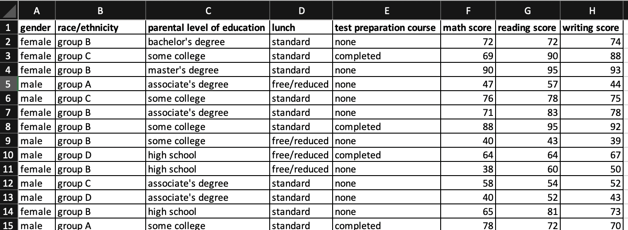
DATA Description (sOURCE: kaggle)
Link of the Dataset:
Source: Kaggle, https://www.kaggle.com/spscientist/students-performance-in-exams?select=StudentsPerformance.csv
Notes:
This is just a glimpse of the top rows of our dataset. The data set downloaded by us from Kaggle contained 1,000 observations and 8 variables, including gender, race, parental level of education, lunch (standard or free/reduced), test preparation course, and the test score of three different exams. As you see on the screen, within these variables, the former five ones are categorical variables and the last three are numerical variables.
One of the first things we did was cleaning the data and finding the rows with missing data or n/a under the exploratory data analysis. Then, we converted some categorical variables to binary i.e create dummy variables for factors.
Then, we used the newly created dummy variables for linear regression. Tree regression can handle factor variable automatically.
After cleaning the data, we conducted descriptive analysis in R. Our exploratory results have been attached in the report and would be discussed in detail. Now Weiwen will discuss about Hypothesis and Methodologies.

Slide 7

Questions &
Hypothesis
How does the factors like gender, parents’ level of education and nutrition will affect students’ test performance
We expect parents’ level of education and the nutrition will have positive influence on the students’ performance

Slide 8
methodologies
Classification
Tree model
Convert variables into dummy variables
Classification standard: median value
Use different criterions: R^2, Adjusted R^2, CP, BIC
Linear Regression
Use training and testing data to evaluate the accuracy
Prune the model to get the best tree

Slide 9
01
Tree model

Slide 10
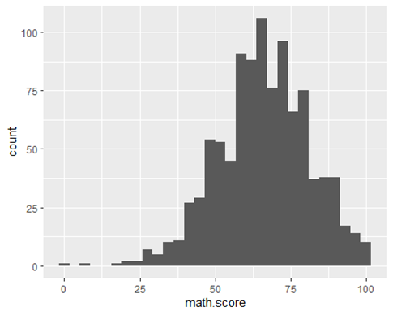
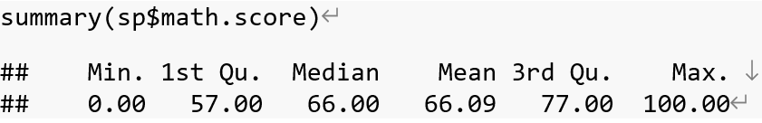
Questions and data preparation
We want to know:
How to define “good at math”?
How these factors affect students’ performance on Math?
Scores higher than 75.
Notes:
Before we actually analyzed the data, we were intuitively predicting how factors like gender, race, parents’ level of education and nutrition affect students’ performance in math. We predicted that parents’ level of education will have a great impact on the students' performance since family, upbringing, and parental educational level plays an important role during a student's growth. However, the model shows that nutrition is the most important factor.
As we can see from the histogram, the distribution of math score is near normal. The 3rd quantile is 77 so we decided to set 75 as a cut point for “students good at math”.

Slide 11
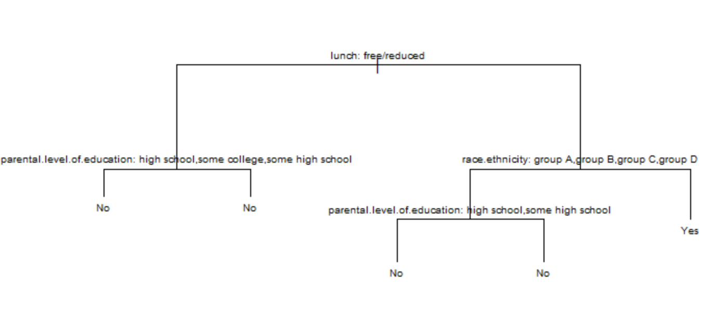
Tree model RESULTS
Findings:
Nutrition matters most
Parents’ education and race also count
Students with great nutrition and are in race group E perform better

Slide 12
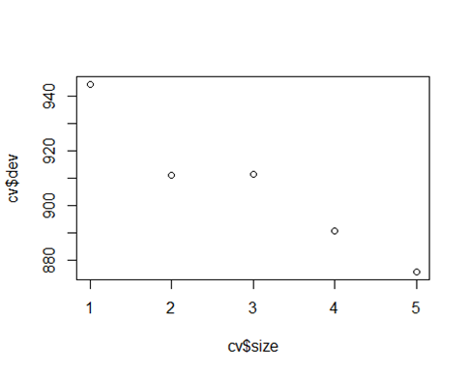
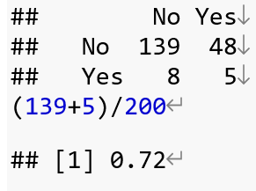
PRUNING AND PREDICTION
pRUNING:
Prediction:
Using k-fold cross-validation
Least MSE when there are 5 nodes
Stick to original model
Confusion matrix is as above
Accuracy rate is 72%

Slide 13
02
Classification model

Slide 14
We want to know:
Solution step:
How these factors affect students’ performance on Total score, math, reading and writing?
Convert variables into dummy variables
Classification standard: median value
Logistic Regression

Slide 15
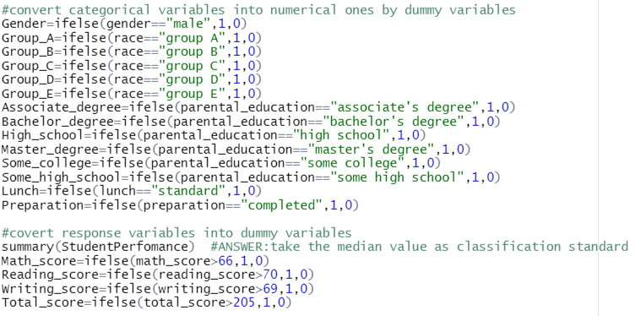
Dummy variables
For some variables, they are binary naturally, but variables like race and education level , they have multiple dimensions, which we separate each level, and treat them as binary (1 for in group_A, 0 for not the Group_A) and increases the sub-factors from 5 to 14 binarys.

Slide 16
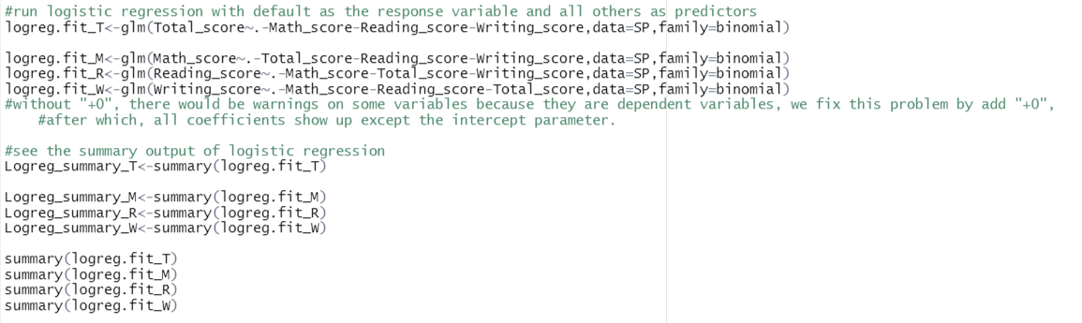
Set standard and do logistic regressions
There is one thing that should be noticed: because the dummy variables are in the same group, they are dependent with each other. Only need k-1 factors. However, when we try to fix this by adding -1 or +0 to make the last dummy variable show up. However, we tried, but it is not successful, it is the limit of our study

Slide 17
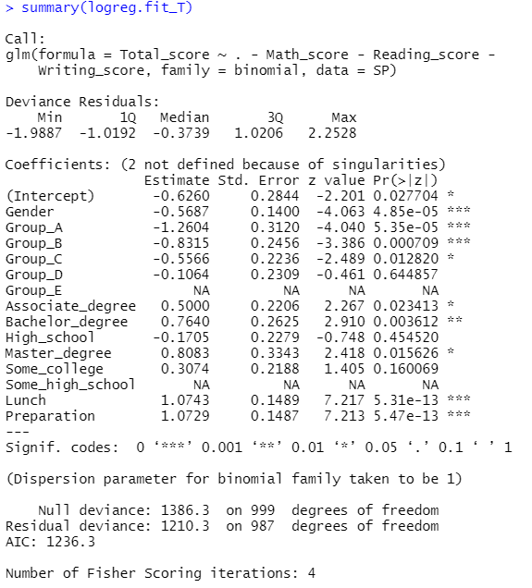
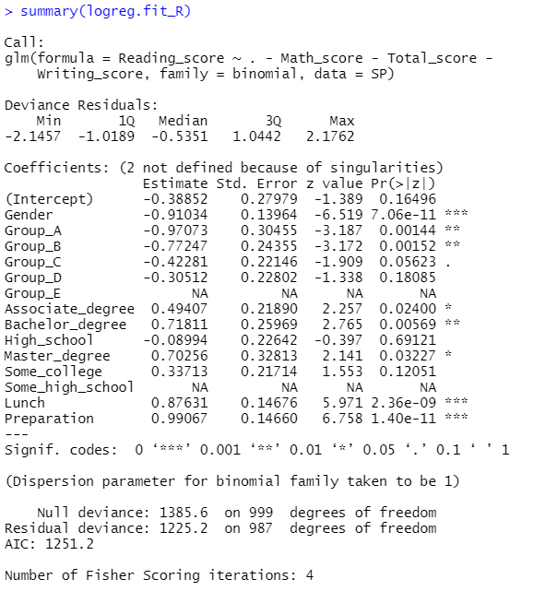
Results

Slide 18
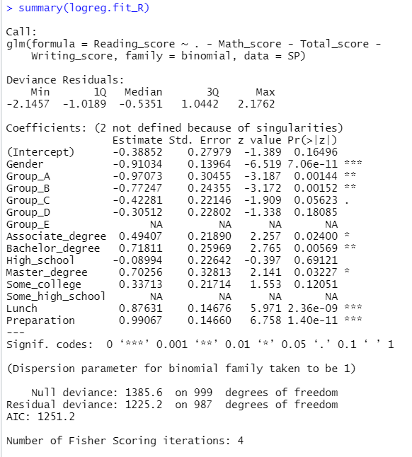
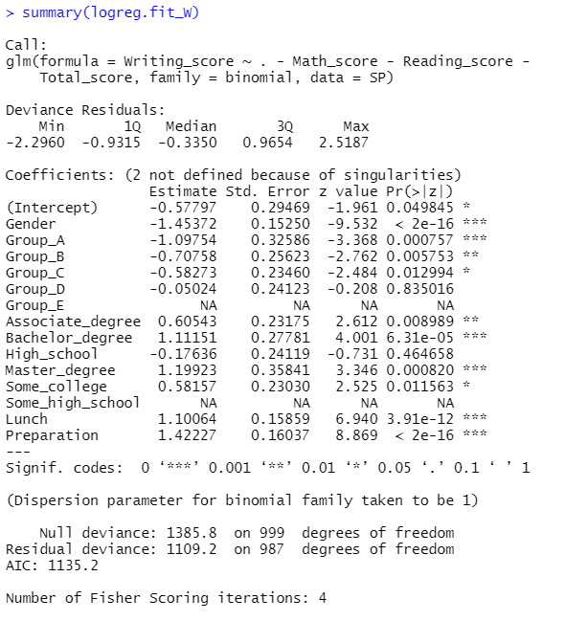
RESULTS

Slide 19
Results and Conclusion
Results
gender, lunch and test preparations, all of the three have a highly significant (alpha is below 0.01%) relationship with score performance
Race affects the math exam mostly, because more sub-factors are significant in the regression, then the writing and least on reading.
For parental education factors, the test score of writing is influenced by it heavily, and then reading, the last is math.
Possible explanations
lunch_-->nutrition-->brain development
Test preparations → familiar with questions in advance
Parent's education level-->home-education and even genetic inheritance
race-->different cultures-->different training skills ( for example, China and India emphasize more on math and physics than other subjects)
However, for gender, we should have thought, female and male may be good at different subjects, but the results don’t support our assumptions, so we are still in discussion.

Slide 20

REferences
Students Performance in Exams. Kaggle. Retrieved from https://www.kaggle.com/spscientist/students-performance-in-exams?select=StudentsPerformance.csv

Slide 21

Thanks!
Credits: All members contributed equally since we wanted to practice everything, analyze everyone’s answers, and learn from each other. We collectively conducted the data collection, data analysis and result interpretation, report writing and ppt.
Notes:
All members contributed equally since we wanted to practice everything, analyze everyone’s answers, and learn from each other. We collectively conducted the data collection, data analysis and result interpretation, report writing and ppt.
Last but not the least, we would like to thank Professor Wang and appreciate him for his valuable suggestions, feedback and support throughout the curriculum. This would not have been possible without you and despite all the members being new to R, we learned alot in this course. Thank you everyone for your patience and attention!

